Slide 1
Vietnam Institute for Advanced Study in Mathematics
7 December 2023
Is Lattice-Based Post-Quantum Cryptography Secure?
Neal Koblitz, koblitz@uw.edu
University of Washington, Seattle

Slide 2
Outline of Talk
● During my visit in 2018 I gave reasons for skepticism about predictions of successful quantum attacks on RSA and Elliptic Curve Cryptography (ECC) any time soon.

Slide 3
Outline of Talk
● During my visit in 2018 I gave reasons for skepticism about predictions of successful quantum attacks on RSA and Elliptic Curve Cryptography (ECC) any time soon.
● What is lattice-based (LWE) post-quantum cryptography? Why did the U.S. government agency NIST endorse it?
.

Slide 4
Outline of Talk
● During my visit in 2018 I gave reasons for skepticism about predictions of successful quantum attacks on RSA and Elliptic Curve Cryptography (ECC) any time soon.
● What is lattice-based (LWE) post-quantum cryptography? Why did the U.S. government agency NIST endorse it?
● The “mathematical proof” of its security — gaps and fallacies.

Slide 5
Outline of Talk
● During my visit in 2018 I gave reasons for skepticism about predictions of successful quantum attacks on RSA and Elliptic Curve Cryptography (ECC) any time soon.
● What is lattice-based (LWE) post-quantum cryptography? Why did the U.S. government agency NIST endorse it?
● The “mathematical proof” of its security — gaps and fallacies.
● An alternative: hybrid LWE-ECC cryptography.

Slide 6
1. Quantum Computation
Exponentially faster than classical computation:

Slide 7
1. Quantum Computation
Exponentially faster than classical computation:
classical — acts on n-bitstrings, that is, elements of an n-dimensional vector space over F₂

Slide 8
1. Quantum Computation
Exponentially faster than classical computation:
classical — acts on n-bitstrings, that is, elements of an n-dimensional vector space over F₂
quantum — acts on elements of a 2^{n}-dimensional vector space over C; the absolute value squared of each complex component is the probability that the corresponding bitstring will be observed

Slide 9
Reasons to doubt that quantum computing can be carried out on a large scale in the near (or medium) future:

Slide 10
Reasons to doubt that quantum computing can be carried out on a large scale in the near (or medium) future:
Huge technical obstacles to scaling: noise and instability —“quantum decoherence”.

Slide 11
Reasons to doubt that quantum computing can be carried out on a large scale in the near (or medium) future:
Huge technical obstacles to scaling: noise and instability —“quantum decoherence”.
No way is known to store data within a quantum system; this greatly limits the types of problems that can be solved and also greatly reduces the financial incentive to continue investing large sums of money in it.

Slide 12
Reasons to doubt that quantum computing can be carried out on a large scale in the near (or medium) future:
Huge technical obstacles to scaling: noise and instability —“quantum decoherence”.
No way is known to store data within a quantum system; this greatly limits the types of problems that can be solved and also greatly reduces the financial incentive to continue investing large sums of money in it.
Over the 2 or 3 decades that large sums of money have been devoted to research and development of quantum computation, progress has been very slow, much slower than initially predicted.

Slide 13
4. Science fiction writers and others who write about future technology have a poor record. For example, the writers of mid-20th century

Slide 14
4. Science fiction writers and others who write about future technology have a poor record. For example, the writers of mid-20th century
failed to predict: email, the Internet, personal computers, smart phones, or social media

Slide 15
4. Science fiction writers and others who write about future technology have a poor record. For example, the writers of mid-20th century
failed to predict: email, the Internet, personal computers, smart phones, or social media
incorrectly predicted: human exploration of other planets, widespread supersonic passenger transportation, nuclear powered cars and home appliances

Slide 16
Advances in technology do not always live up to expectations.

Slide 17
Advances in technology do not always live up to expectations.
1957 — Soviet Union launches Sputnik, 1st satellite

Slide 18
Advances in technology do not always live up to expectations.
1957 — Soviet Union launches Sputnik, 1st satellite
1961 — Soviet astronaut Uri Gagarin, 1st human to orbit Earth

Slide 19
Advances in technology do not always live up to expectations.
1957 — Soviet Union launches Sputnik, 1st satellite
1961 — Soviet astronaut Uri Gagarin, 1st human to orbit Earth
1969 — American astronaut Neil Armstrong, 1st human on the Moon

Slide 20
Advances in technology do not always live up to expectations.
1957 — Soviet Union launches Sputnik, 1st satellite
1961 — Soviet astronaut Uri Gagarin, 1st human to orbit Earth
1969 — American astronaut Neil Armstrong, 1st human on the Moon
1972 - present — no human goes beyond Earth orbit

Slide 21
Advances in technology do not always live up to expectations.
1957 — Soviet Union launches Sputnik, 1st satellite
1961 — Soviet astronaut Uri Gagarin, 1st human to orbit Earth
1969 — American astronaut Neil Armstrong, 1st human on the Moon
1972 - present — no human goes beyond Earth orbit
2023 — goal of NASA and the space agencies of several other countries is to send a human to the moon again

Slide 22
There is no urgency in transitioning to “quantum-safe” cryptography. We have many years — enough time to do it carefully.

Slide 23
There is no urgency in transitioning to “quantum-safe” cryptography. We have many years — enough time to do it carefully.
What about the possibility that currently encrypted secrets are being stored by adversaries and criminals, who are waiting until quantum computers can break the encryption?

Slide 24
There is no urgency in transitioning to “quantum-safe” cryptography. We have many years — enough time to do it carefully.
What about the possibility that currently encrypted secrets are being stored by adversaries and criminals, who are waiting until quantum computers can break the encryption?
We should ask: What needs to be secret even decades from now? Not cryptography used for digital signatures, access codes, hiding credit card numbers, etc.

Slide 25
In practice, relatively little needs to remain secret for 30 or 40 years.

Slide 26
In practice, relatively little needs to remain secret for 30 or 40 years. Most of that should in any case be protected by a layer of private key encryption, such as AES at high security levels, which is believed to be secure even against quantum computation.

Slide 27
In practice, relatively little needs to remain secret for 30 or 40 years. Most of that should in any case be protected by a layer of private key encryption, such as AES at high security levels, which is believed to be secure even against quantum computation.
Identifying those super-secret messages that need extra protection, and then putting on AES (with a key exchange that does not rely on RSA or ECC security) is easier and less risky than transitioning to a completely new kind of encryption.

Slide 28
To those who argue for quick adoption of lattice-based post-quantum cryptography I respond: How can we be sure that a system of data protection that has not been extensively tested or used will be secure and protect that super-secret encrypted data for 30 or 40 years?

Slide 29
To those who argue for quick adoption of lattice-based post-quantum cryptography I respond: How can we be sure that a system of data protection that has not been extensively tested or used will be secure and protect that super-secret encrypted data for 30 or 40 years?
As I will show, the so-called “guarantees” of the security of lattice-based cryptography that come from purely mathematical arguments are invalid.

Slide 30
To those who argue for quick adoption of lattice-based post-quantum cryptography I respond: How can we be sure that a system of data protection that has not been extensively tested or used will be secure and protect that super-secret encrypted data for 30 or 40 years?
As I will show, the so-called “guarantees” of the security of lattice-based cryptography that come from purely mathematical arguments are invalid.
They guarantee nothing.

Slide 31
Last year the U.S. government agency National Institute of Standards and Technology (NIST) recommended a transition from RSA and ECC to certain lattice-based cryptosystems. The agency expressed confidence in their security.

Slide 32
Last year the U.S. government agency National Institute of Standards and Technology (NIST) recommended a transition from RSA and ECC to certain lattice-based cryptosystems. The agency expressed confidence in their security.
Lattice-based cryptography is much more complicated than RSA or ECC. It’s more difficult to achieve confidence in the security of a complicated system than in a simpler one.

Slide 33
The conjecturally hard computational problems that the security of the most important public key cryptosystems rely on:

Slide 34
The conjecturally hard computational problems that the security of the most important public key cryptosystems rely on:
RSA: integer factorization (given N=pq, find p and q).

Slide 35
The conjecturally hard computational problems that the security of the most important public key cryptosystems rely on:
RSA: integer factorization (given N=pq, find p and q).
ECC: elliptic curve discrete logarithm (given points P and Q with Q a multiple of P, find k such that Q=kP).

Slide 36
The conjecturally hard computational problems that the security of the most important public key cryptosystems rely on:
RSA: integer factorization (given N=pq, find p and q).
ECC: elliptic curve discrete logarithm (given points P and Q with Q a multiple of P, find k such that Q=kP).
Lattice-based: “learning with errors” (LWE) — essentially a linear algebra problem where the vector of constants contains a random error according to a certain error distribution.

Slide 37
To be more precise, I’ll describe the example of an LWE-based bit-encryption system that was proposed in an important early article by Oded Regev in 2009.

Slide 38
To be more precise, I’ll describe the example of an LWE-based bit-encryption system that was proposed in an important early article by Oded Regev in 2009.
● n ≈ 1024
● n² < p < 2n² is a prime
● m ≈ (1+ε) n log p
● χ is a (Gaussian) probability distribution on Z/pZ

Slide 39
● the secret key: a random element s in (Z/pZ)^{n}

Slide 40
● the secret key: a random element s in (Z/pZ)^{n}
● the public key: (a,b)=(a_{i} , b_{i})_{i=1,…,m} ,
where the vectors a_{i} in (Z/pZ)^{n} (the rows of an m x n matrix) are chosen randomly and b_{i} = ˂a_{i}, s˃ + e_{i} with the e_{i} in Z/pZ chosen randomly according to the distribution χ.

Slide 41
● the secret key: a random element s in (Z/pZ)^{n}
● the public key: (a,b)=(a_{i} , b_{i})_{i=1,…,m} ,
where the vectors a_{i} in (Z/pZ)^{n} (the rows of an m x n matrix) are chosen randomly and b_{i} = ˂a_{i}, s˃ + e_{i} with the e_{i} in Z/pZ chosen randomly according to the distribution χ.
That is, the vector b in (Z/pZ)^{m} is the result of applying the matrix a to the vector s followed by a perturbation by the error vector e.

Slide 42
● to encrypt a bit: randomly choose a subset S in {1,…,m}; the bit 0 is encrypted as (∑_{i ɛ S} a_{i} , ∑_{i ɛ S} b_{i}), and the bit 1 is encrypted as (∑_{i ɛ S} a_{i} , (p ̶ 1)/2 + ∑_{i ɛ S} b_{i}).

Slide 43
● to encrypt a bit: randomly choose a subset S in {1,…,m}; the bit 0 is encrypted as (∑_{i ɛ S} a_{i} , ∑_{i ɛ S} b_{i}), and the bit 1 is encrypted as (∑_{i ɛ S} a_{i} , (p ̶ 1)/2 + ∑_{i ɛ S} b_{i}).
● to decrypt: (a, b) decrypts to the bit 0 if the difference b ̶ <a, s> modulo p is closer to 0 than to (p – 1)/2; otherwise, (a, b) decrypts to the bit 1.

Slide 44
Both the integer factorization problem that RSA is based on and the elliptic curve discrete logarithm problem that ECC is based on have “stood the test of time.”

Slide 45
Both the integer factorization problem that RSA is based on and the elliptic curve discrete logarithm problem that ECC is based on have “stood the test of time.” That is, since the 1980s they have survived many attempts to find algorithms that will — within a reasonable amount of time — solve the cases of the problems that arise in cryptography.

Slide 46
Both the integer factorization problem that RSA is based on and the elliptic curve discrete logarithm problem that ECC is based on have “stood the test of time.” That is, since the 1980s they have survived many attempts to find algorithms that will — within a reasonable amount of time — solve the cases of the problems that arise in cryptography.
However, we do not have much direct evidence that LWE is intractable, that is, that the learning with errors problems that occur in trying to break an LWE-based cryptosystem in practice are too difficult to solve now or in the near future.

Slide 47
For this reason the promoters and advocates for LWE-based cryptography take a theoretical approach, making their case for security by proving reduction theorems that relate the hardness of LWE to that of a well-known classical problem that has been studied for much longer than LWE.

Slide 48
For this reason the promoters and advocates for LWE-based cryptography take a theoretical approach, making their case for security by proving reduction theorems that relate the hardness of LWE to that of a well-known classical problem that has been studied for much longer than LWE.
By “reducing” a computational problem P to a problem Q,
we mean constructing an algorithm that, given a Q-solver (that finds solutions to Q) and some input to the problem P, can efficiently (counting the time needed to run the Q-solver as one unit of time) solve the problem P.

Slide 49
Some well-known examples:
The problem of solving quadratic equations reduces to finding square roots.

Slide 50
Some well-known examples:
The problem of solving quadratic equations reduces to finding square roots.
The problem of finding square roots modulo an integer N reduces to factoring N into prime factors.

Slide 51
The idea of a mathematical reduction in cryptography is that, if P reduces to Q, and if we have evidence that P is intractable, then that also provides evidence of the same for Q.

Slide 52
The idea of a mathematical reduction in cryptography is that, if P reduces to Q, and if we have evidence that P is intractable, then that also provides evidence of the same for Q.
More precisely, if our experience with the well-studied problem P shows that the instances of P that reduce to the instances of Q arising in cryptography require time at least t(P) to solve, and if the reduction procedure takes time much less than t(P), then it follows that cryptographic instances of Q take time at least of magnitude t(P).

Slide 53
The idea of a mathematical reduction in cryptography is that, if P reduces to Q, and if we have evidence that P is intractable, then that also provides evidence of the same for Q.
More precisely, if our experience with the well-studied problem P shows that the instances of P that reduce to the instances of Q arising in cryptography require time at least t(P) to solve, and if the reduction procedure takes time much less than t(P), then it follows that cryptographic instances of Q take time at least of magnitude t(P). We call such a result provable security.

Slide 54
However, it is important to note that, if the reduction algorithm requires us to solve 2^{k} instances of the problem Q in order to solve an instance of P, then we have only proved that t(Q) cannot be much less than
t(P)/2^{k} .

Slide 55
However, it is important to note that, if the reduction algorithm requires us to solve 2^{k} instances of the problem Q in order to solve an instance of P, then we have only proved that t(Q) cannot be much less than
t(P)/2^{k} .
In this situation we say that 2^{k} is the tightness gap in the provable security result.

Slide 56
From the beginning the promoters of lattice-based cryptography have relied upon “provable security” theorems to support the claim that this type of cryptography is superior to others and has an adequate level of security.

Slide 57
From the beginning the promoters of lattice-based cryptography have relied upon “provable security” theorems to support the claim that this type of cryptography is superior to others and has an adequate level of security.
Chris Peikert is probably the best known advocate of lattice-based cryptography. He has stated that the “provable security” results that he and his coauthors have proved are a source of “hard-and-fast guarantees” of security.

Slide 58
I and three coauthors from the Indian Statistical Institute in Kolkata carefully examined one of the most important articles in the development of LWE-based cryptography: Lyubashevsky, Peikert, and Regev, “On ideal lattices and learning with errors over rings,” J. ACM, 2013.

Slide 59
I and three coauthors from the Indian Statistical Institute in Kolkata carefully examined one of the most important articles in the development of LWE-based cryptography: Lyubashevsky, Peikert, and Regev, “On ideal lattices and learning with errors over rings,” J. ACM, 2013.
The central result of that article is a provable security theorem relating LWE to an important computational problem denoted SIVP_{Г}.

Slide 60
SIVP_{Г} is the approximate Short Independent Vectors Problem with approximation factor Г.

Slide 61
SIVP_{Г} is the approximate Short Independent Vectors Problem with approximation factor Г.
Given an n-dimensional lattice L, this is the problem of finding n independent vectors in L such that the longest of these vectors has length at most Гλ, where λ is the length of the shortest vector among all longest vectors of a set of n independent lattice vectors:
λ = min_{S}{|v| : S is a set of n independent vectors
in L and v is a longest vector in S}.

Slide 62
Theorem of Peikert, Lyubashevsky, and Regev (informal version). For lattices that come from number rings, the problem SIVP_{Г} reduces in polynomial time to the problem decision-LWE (denoted DLWE).

Slide 63
Theorem of Peikert, Lyubashevsky, and Regev (informal version). For lattices that come from number rings, the problem SIVP_{Г} reduces in polynomial time to the problem decision-LWE (denoted DLWE).
The proof of this theorem has a complicated structure, consisting of 9 nested sub-reductions.
This structure can be visualized as a set of 9 Russian “matryoshka dolls”:

Slide 64
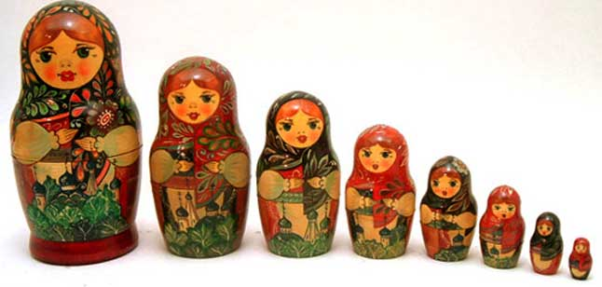

Slide 65
This structure has two serious consequences:

Slide 66
This structure has two serious consequences:
● the tightness gaps of the sub-reductions multiply together to give the tightness gap of the complete reduction;

Slide 67
This structure has two serious consequences:
● the tightness gaps of the sub-reductions multiply together to give the tightness gap of the complete reduction;
● 7 of the 9 sub-reductions occur within a quantum computer that is in the process of analyzing a certain quantum state, that is, a certain fixed vector in a Hilbert space of dimension 2^{n}.

Slide 68
This structure has two serious consequences:
● the tightness gaps of the sub-reductions multiply together to give the tightness gap of the complete reduction;
● 7 of the 9 sub-reductions occur within a quantum computer that is in the process of analyzing a certain quantum state, that is, a certain fixed vector in a Hilbert space of dimension 2^{n}. Moreover, certain values must be stored between different sub-reductions. However, no one knows how to preserve information in this manner, because in quantum physics observation of a quantum state destroys the state.

Slide 69
Other difficulties with the Lyubashevsky-Peikert-Regev reduction:

Slide 70
Other difficulties with the Lyubashevsky-Peikert-Regev reduction:
● Using various practical values of the parameters, we calculated the following tightness gaps 2^{k} :
k = 1556, 737, 475
Thus, the reduction implies only the lower bound
t(DLWE) $≥$ t(SIVP_{Γ})/2⁴⁷⁵.

Slide 71
Other difficulties with the Lyubashevsky-Peikert-Regev reduction:
● Using various practical values of the parameters, we calculated the following tightness gaps 2^{k} :
k = 1556, 737, 475
Thus, the reduction implies only the lower bound
t(DLWE) $≥$ t(SIVP_{Γ})/2⁴⁷⁵.
From a practical standpoint it is completely wrong to say that this theorem implies that DLWE is at least as hard as SIVP_{Г}.

Slide 72
● When the approximation factor Г is 1, that is, when we want to solve the exact Shortest Independent Vectors Problem SIVP, there is empirical evidence of the intractability of SIVP = SIVP_{Γ=1} for general lattices.

Slide 73
● When the approximation factor Г is 1, that is, when we want to solve the exact Shortest Independent Vectors Problem SIVP, there is empirical evidence of the intractability of SIVP = SIVP_{Γ=1} for general lattices.
But when we compute the values of Г that arise in the proof for practical values of the parameters, we find that the approximation factors are so large that the corresponding SIVP_{Γ} are not likely to be very difficult.

Slide 74
● The quantum part of the reduction requires approximately 3n² logical “qubits,” that is, the Hilbert space has dimension
≈ 2$3n$².

Slide 75
● The quantum part of the reduction requires approximately 3n² logical “qubits,” that is, the Hilbert space has dimension
≈ 2$3n$². (“Logical qubits” means that we are not providing error-correction to handle quantum decoherence; in reality, the number of physical qubits needed is estimated to be about 1000 times the number of logical qubits.)

Slide 76
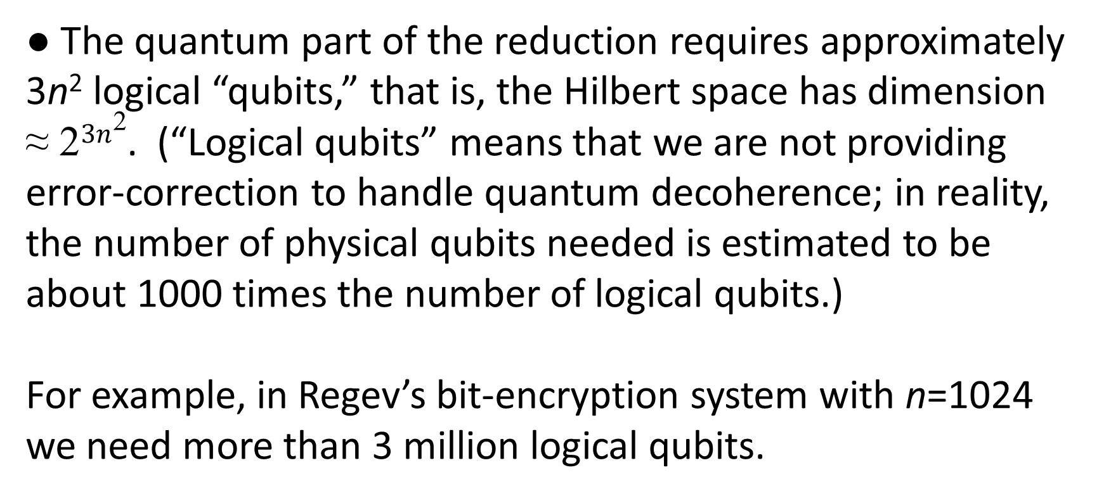
● The quantum part of the reduction requires approximately 3n² logical “qubits,” that is, the Hilbert space has dimension
≈ 2$3n$². (“Logical qubits” means that we are not providing error-correction to handle quantum decoherence; in reality, the number of physical qubits needed is estimated to be about 1000 times the number of logical qubits.)
For example, in Regev’s bit-encryption system with n=1024 we need more than 3 million logical qubits.

Slide 77
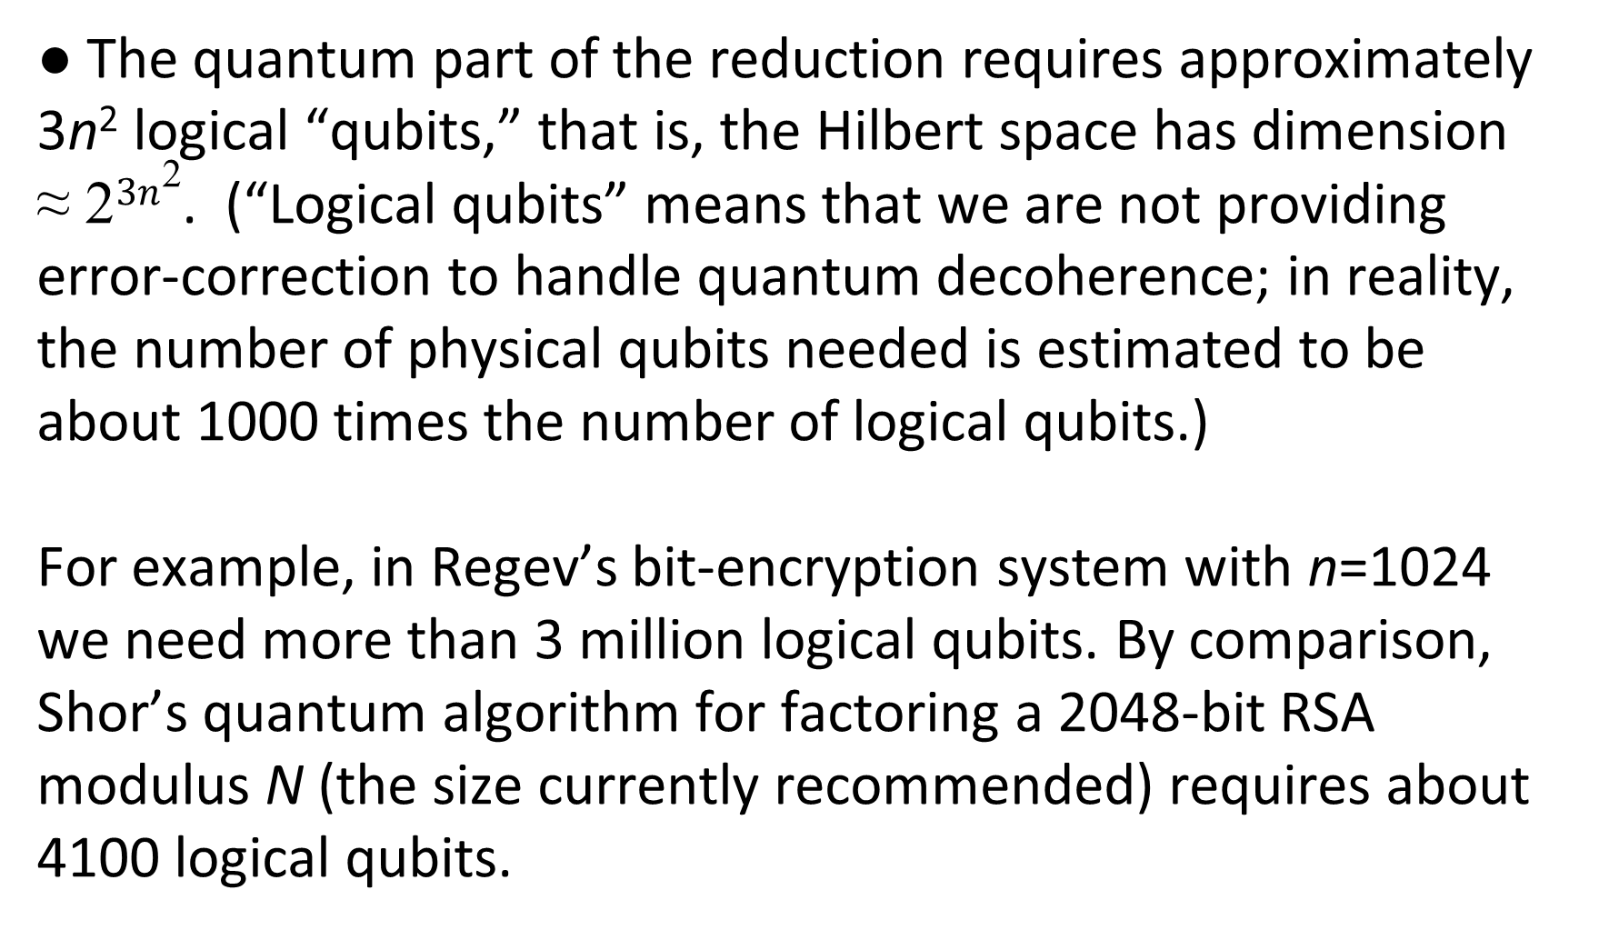
● The quantum part of the reduction requires approximately 3n² logical “qubits,” that is, the Hilbert space has dimension
≈ 2$3n$². (“Logical qubits” means that we are not providing error-correction to handle quantum decoherence; in reality, the number of physical qubits needed is estimated to be about 1000 times the number of logical qubits.)
For example, in Regev’s bit-encryption system with n=1024 we need more than 3 million logical qubits. By comparison, Shor’s quantum algorithm for factoring a 2048-bit RSA modulus N (the size currently recommended) requires about 4100 logical qubits.

Slide 78
Thus, even if we have quantum computers capable of breaking RSA and ECC, it does not follow that they would be powerful enough to carry out the reduction algorithm in the theorem.

Slide 79
Thus, even if we have quantum computers capable of breaking RSA and ECC, it does not follow that they would be powerful enough to carry out the reduction algorithm in the theorem.
● It is estimated that the number of gates in the quantum circuit grows approximately in proportion to the cube of the number of qubits.

Slide 80
Thus, even if we have quantum computers capable of breaking RSA and ECC, it does not follow that they would be powerful enough to carry out the reduction algorithm in the theorem.
● It is estimated that the number of gates in the quantum circuit grows approximately in proportion to the cube of the number of qubits. This means that the number of gates required for the reduction is ≈ 400 million times greater than the number of gates required for Shor’s algorithm.

Slide 81
● The problem SIVP is believed to be very difficult for general lattices, but not necessarily when restricted to special classes of lattices.

Slide 82
● The problem SIVP is believed to be very difficult for general lattices, but not necessarily when restricted to special classes of lattices.
For efficiency, LWE-based cryptography in practice only uses classes of lattices that have extra structure, for example, lattices of ideals or modules of number rings.

Slide 83
● The problem SIVP is believed to be very difficult for general lattices, but not necessarily when restricted to special classes of lattices.
For efficiency, LWE-based cryptography in practice only uses classes of lattices that have extra structure, for example, lattices of ideals or modules of number rings. Often the lattices are taken from cyclotomic number rings (formed from roots of unity), which have even more structure than the lattices of other number rings.

Slide 84
● The problem SIVP is believed to be very difficult for general lattices, but not necessarily when restricted to special classes of lattices.
For efficiency, LWE-based cryptography in practice only uses classes of lattices that have extra structure, for example, lattices of ideals or modules of number rings. Often the lattices are taken from cyclotomic number rings (formed from roots of unity), which have even more structure than the lattices of other number rings. It is unknown whether or not SIVP is a difficult problem for ideals or modules of cyclotomic rings.

Slide 85
A simple way to see how special cyclotomic ideal lattices are compared to general lattices is to look at dimension n = 2.

Slide 86
A simple way to see how special cyclotomic ideal lattices are compared to general lattices is to look at dimension n = 2. Any two independent vectors in the plane span a lattice. To find a short basis is simple but not completely trivial using Gauss’s lattice reduction algorithm.

Slide 87
A simple way to see how special cyclotomic ideal lattices are compared to general lattices is to look at dimension n = 2. Any two independent vectors in the plane span a lattice. To find a short basis is simple but not completely trivial using Gauss’s lattice reduction algorithm.
In contrast, the only cyclotomic ideal lattices when n = 2 are the tilings of the plane by squares or by equilateral triangles, where the short basis problem is completely trivial.

Slide 88
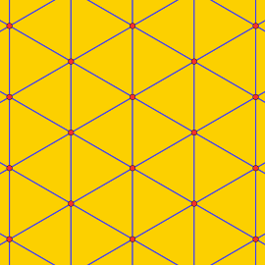
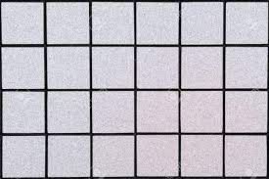

Slide 89
Each one of these is a serious weakness or gap in the proof of the Lyubachevsky-Peikert-Regev “provable security” theorem.

Slide 90
Each one of these is a serious weakness or gap in the proof of the Lyubachevsky-Peikert-Regev “provable security” theorem. Cumulatively, they show that the theorem gives no assurance of security at all.

Slide 91
Each one of these is a serious weakness or gap in the proof of the Lyubachevsky-Peikert-Regev “provable security” theorem. Cumulatively, they show that the theorem gives no assurance of security at all.
Note that our work is concerned with the fallacious use of that theorem and the security assurances that are claimed to follow from the theorem.

Slide 92
Each one of these is a serious weakness or gap in the proof of the Lyubachevsky-Peikert-Regev “provable security” theorem. Cumulatively, they show that the theorem gives no assurance of security at all.
Note that our work is concerned with the fallacious use of that theorem and the security assurances that are claimed to follow from the theorem. We have not looked for concrete attacks on LWE-based systems.

Slide 93
However, other researchers have studied attacks. The work of MATZOV is particularly interesting.

Slide 94
However, other researchers have studied attacks. The work of MATZOV is particularly interesting.
MATZOV = the Hebrew abbreviation of the name of the cryptographic arm of the Israeli Defense Forces.

Slide 95
However, other researchers have studied attacks. The work of MATZOV is particularly interesting.
MATZOV = the Hebrew abbreviation of the name of the cryptographic arm of the Israeli Defense Forces.
In April 2022, just two months before NIST announced its decision recommending LWE-based systems, MATZOV published a 54-page preprint titled “Report on the Security of LWE: Improved Dual Lattice Attack.”

Slide 96
Summary of the MATZOV report :

Slide 97
Summary of the MATZOV report :
● Their “improved dual lattice attack” in its present form is not practical with today’s technology.

Slide 98
Summary of the MATZOV report :
● Their “improved dual lattice attack” in its present form is not practical with today’s technology.
● However, in §8 of the preprint they discuss major improvements in the attack that MATZOV and other researchers are likely to make in the coming years.

Slide 99
Summary of the MATZOV report :
● Their “improved dual lattice attack” in its present form is not practical with today’s technology.
● However, in §8 of the preprint they discuss major improvements in the attack that MATZOV and other researchers are likely to make in the coming years.
● In the meantime MATZOV has shown that the true level of security of the LWE-based systems under consideration by NIST (that is, their resistance to attacks) is lower than claimed by their promoters.

Slide 100
● In at least one case the true security is demonstrably less than the level required by NIST for approval.

Slide 101
● In at least one case the true security is demonstrably less than the level required by NIST for approval.
New cryptosystems are required to be secure against known attacks with enough extra margin so as to resist the gradual future advances in algorithms and technology — for example,
improved ASICs. (ASIC = application-specific integrated circuit, that is, hardware specially constructed for the algorithm)

Slide 102
● In at least one case the true security is demonstrably less than the level required by NIST for approval.
New cryptosystems are required to be secure against known attacks with enough extra margin so as to resist the gradual future advances in algorithms and technology — for example,
improved ASICs. (ASIC = application-specific integrated circuit, that is, hardware specially constructed for the algorithm)
● MATZOV’s overall conclusion is that the security question for LWE-based systems is unresolved, and that type of cryptography still needs to pass the test of time.

Slide 103
As far as I know, this report was the first time that the super-secret organization MATZOV commented publicly about a controversy in cryptography.

Slide 104
As far as I know, this report was the first time that the super-secret organization MATZOV commented publicly about a controversy in cryptography.
Despite MATZOV’s close relations with the U.S. National Security Agency (NSA), the viewpoint in the preprint is in direct conflict with NSA’s opinion, which supports the adoption of LWE-systems.

Slide 105
NIST paid little attention to MATZOV’s report and did not comment on it in detail. The promoters of LWE-systems also did not give a serious response to the report.

Slide 106
NIST paid little attention to MATZOV’s report and did not comment on it in detail. The promoters of LWE-systems also did not give a serious response to the report.
In February 2022, I had sent an advance copy of our paper to Dustin Moody, who directs NIST’s post-quantum cryptography project. (He’s a former PhD student of mine.)

Slide 107
NIST paid little attention to MATZOV’s report and did not comment on it in detail. The promoters of LWE-systems also did not give a serious response to the report.
In February 2022, I had sent an advance copy of our paper to Dustin Moody, who directs NIST’s post-quantum cryptography project. (He’s a former PhD student of mine.) NIST also paid little attention to that paper.

Slide 108
NIST paid little attention to MATZOV’s report and did not comment on it in detail. The promoters of LWE-systems also did not give a serious response to the report.
In February 2022, I had sent an advance copy of our paper to Dustin Moody, who directs NIST’s post-quantum cryptography project. (He’s a former PhD student of mine.) NIST also paid little attention to that paper.
I believe that NIST felt under pressure to approve post-quantum systems quickly, despite the absence of any near-term threat from quantum computation.

Slide 109
Why?

Slide 110
Why? Most likely NIST was following the lead of the NSA, which in 2015 had published a recommendation that users of cryptography make a transition as soon as possible from RSA and ECC to post-quantum systems.

Slide 111
Why? Most likely NIST was following the lead of the NSA, which in 2015 had published a recommendation that users of cryptography make a transition as soon as possible from RSA and ECC to post-quantum systems.
Why did the NSA make such a recommendation, despite the absence of urgency and the presence of much controversy and uncertainty about security issues?

Slide 112
Why? Most likely NIST was following the lead of the NSA, which in 2015 had published a recommendation that users of cryptography make a transition as soon as possible from RSA and ECC to post-quantum systems.
Why did the NSA make such a recommendation, despite the absence of urgency and the presence of much controversy and uncertainty about security issues?
I don’t know. But I have a theory.

Slide 113
In the 1990s, when ECC was competing with RSA, the NSA was supportive of ECC, and the NSA played a role in getting it adopted and getting standards approved.

Slide 114
In the 1990s, when ECC was competing with RSA, the NSA was supportive of ECC, and the NSA played a role in getting it adopted and getting standards approved. As far as we know, the NSA at this time was truly interested in strengthening computer security for the private sector as well as the U.S. government and military.

Slide 115
In the 1990s, when ECC was competing with RSA, the NSA was supportive of ECC, and the NSA played a role in getting it adopted and getting standards approved. As far as we know, the NSA at this time was truly interested in strengthening computer security for the private sector as well as the U.S. government and military.
But one of the shocking revelations that Edward Snowden made in 2013 was that in the early 2000s the NSA had put a “back door” in an elliptic-curve-based random number generator.

Slide 116
In the 1990s, when ECC was competing with RSA, the NSA was supportive of ECC, and the NSA played a role in getting it adopted and getting standards approved. As far as we know, the NSA at this time was truly interested in strengthening computer security for the private sector as well as the U.S. government and military.
But one of the shocking revelations that Edward Snowden made in 2013 was that in the early 2000s the NSA had put a “back door” in an elliptic-curve-based random number generator. The back door would enable the NSA to read messages that were encrypted using those random numbers.

Slide 117
It was also revealed that the NSA had paid a bribe to the RSA company so that it would include the corrupted random number generator as the default option in its toolkit. This ensured widespread use of the generator.

Slide 118
It was also revealed that the NSA had paid a bribe to the RSA company so that it would include the corrupted random number generator as the default option in its toolkit. This ensured widespread use of the generator.
Among cryptographers and computer security people there was much outrage at these revelations.

Slide 119
It was also revealed that the NSA had paid a bribe to the RSA company so that it would include the corrupted random number generator as the default option in its toolkit. This ensured widespread use of the generator.
Among cryptographers and computer security people there was much outrage at these revelations. Some even started to doubt all of ECC, although there was no evidence that the NSA had corrupted other elliptic-curve-based systems.

Slide 120
It was also revealed that the NSA had paid a bribe to the RSA company so that it would include the corrupted random number generator as the default option in its toolkit. This ensured widespread use of the generator.
Among cryptographers and computer security people there was much outrage at these revelations. Some even started to doubt all of ECC, although there was no evidence that the NSA had corrupted other elliptic-curve-based systems.
The NSA’s reputation in the private sector plummeted.

Slide 121
The NSA, as a large bureaucratic agency of the U.S. government,
most likely saw a need to quickly restore its credibility. It would lose much of its authority, influence, and budget if it was no longer able to advise the private sector and be listened to.
I believe that it saw that its credibility could not be restored by continuing to give advice about new or improved ECC standards. In fact, it would be best to shift attention far away from ECC, so that the NSA sabotage of the ECC random number standard would fade from people’s memory. That’s my theory about why the NSA, and consequently NIST as well, would have wanted to transition so quickly to purely post-quantum cryptosystems.

Slide 122
My opinion concerning what should be done
(a common one among cryptographers):

Slide 123
My opinion concerning what should be done
(a common one among cryptographers):
As I said before, all the LWE-based cryptosystems are much more complicated than RSA or ECC, and in general it’s more difficult to achieve confidence in the security of a complicated system than in the security of a simple system.

Slide 124
My opinion concerning what should be done
(a common one among cryptographers):
As I said before, all the LWE-based cryptosystems are much more complicated than RSA or ECC, and in general it’s more difficult to achieve confidence in the security of a complicated system than in the security of a simple system.
Thus, it would be risky to abandon RSA/ECC and adopt only lattice-based systems, which have not yet stood the test of time.

Slide 125
In this situation I think that the sensible solution would be to develop and standardize hybrid protocols, based both on elliptic curves and on lattices.

Slide 126
In this situation I think that the sensible solution would be to develop and standardize hybrid protocols, based both on elliptic curves and on lattices. That is, it should be necessary for an adversary to solve both an elliptic curve problem and
a lattice problem in order to hack into the system.

Slide 127
In this situation I think that the sensible solution would be to develop and standardize hybrid protocols, based both on elliptic curves and on lattices. That is, it should be necessary for an adversary to solve both an elliptic curve problem and
a lattice problem in order to hack into the system.
The arrival of quantum computers on a sufficient scale to break ECC is seeming farther and farther in the future. So with the use of ECC in the hybrid system we will have the time that’s needed to improve lattice-based systems and avoid disaster if in a few years the currently standardized ones turn out to be insecure.

Slide 128
I want to conclude by mentioning an announcement earlier this year that shows that some computer security people at Google also favor a hybrid system.
The announcement was discussed in an article in

Slide 129
NOTES:
FIDO2 = a standard for secure log-in to websites using 2-factor authentication
ECDSA = the ECC system for digital signatures
Dilithium = a lattice-based post-quantum algorithm for use with signatures, recommended by NIST in 2022

Slide 130
“Google announces new algorithm that makes FIDO encryption safe from quantum computers.
New approach combines ECDSA with post-quantum algorithm called Dilithium.”
Dan Goodin — 18/8/2023, 1:01 PM

Slide 131
Thank you!

